Slide 1
Selecting, Applying and Interpreting Climate Projections for Hydrologic Modelling: The Forcing Ensemble CSHS Workshop July 21st, 2022
Arelia T. Schoeneberg (née Werner)

Slide 2
Objectives
To describe goals for Hydrologic Projections study design
To introduce PCIC’s methods for GCM selection
To understand the strengths and weaknesses of PCIC’s climate projections
Downscaling Method
Gridded Observations
To walk through
Analysis Tool
https://pacificclimate.org/analysis-tools/pcic-climate-explorer
Data Portal
https://pacificclimate.org/data/statistically-downscaled-climate-scenarios

Slide 3
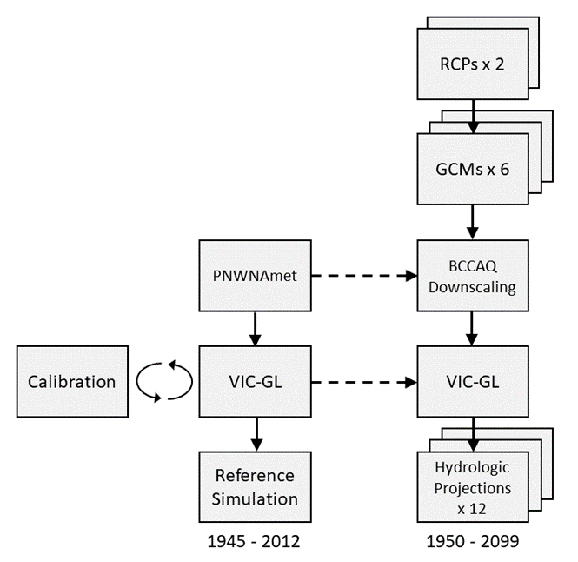
Possible future hydrologic conditions are estimated by forcing a hydrologic model with multiple future climate conditions.
Representative Concentration Pathways (RCPs)
Daily Gridded Meteorological Data “Observations”
Global Climate Models (GCMs)
NRCANmet
Statistical Downscaling
Hydrologic Model
Hydrologic Projections
Hydrologic Projection Study Design – RCPs – GCMs – CMIP5 GCM Selection – BCCAQv2 Statistical Downscaling Technique

Slide 4
The Representative Concentration Pathways (RCPs) used in the fifth Coupled Model Intercomparison Projection (CMIP5) describe emissions pathways leading to different levels of warming by the end of this century.
RCP 8.5 refers to the concentration of carbon that delivers global warming at an average of 8.5 watts per square meter across the planet.
Hydrologic Projection Study Design – RCPs – GCMs – CMIP5 GCM Selection – BCCAQv2 Statistical Downscaling Technique

Slide 5
We are certain that the future is uncertain, that is why we have to look at range of possible futures.
Range in mean temperature change at the end of the century between RCP 4.5 and RCP 8.5
https://pacificclimate.org/sites/default/files/publications/Revised_Hydro_Scenarios_ENV_Water_Use_Allocation_Report_21Jun2021.pdf
Hydrologic Projection Study Design – RCPs – GCMs – CMIP5 GCM Selection – BCCAQv2 Statistical Downscaling Technique

Slide 6
We are certain that the future is uncertain, that is why we have to look at range of possible futures.
Range in mean temperature change at the end of the century between GCMs and natural variability for RCP 4.5 and RCP 8.5
https://pacificclimate.org/sites/default/files/publications/Revised_Hydro_Scenarios_ENV_Water_Use_Allocation_Report_21Jun2021.pdf
Hydrologic Projection Study Design – RCPs – GCMs – CMIP5 GCM Selection – BCCAQv2 Statistical Downscaling Technique

Slide 7
PCIC has a method for sub-setting the CMIP5 GCMs that captures the range in future climate by region.
For CMIP5, PCIC employed the algorithm of Katsavounidis-Kuo-Zhang (KKZ), as implemented by Cannon (2015), computing Euclidean distance in multi-dimensional space between standardized variables and those from the entire ensemble, according to:
Bivariate case
Select GCM closest to ensemble mean first;
Select GCM furthest from this model next;
Select subsequent GCMs to be furthest from the model closest to the centroid of the already-selected models
Repeat from step 3. until specified stopping criterion (e.g., max. range of changes vs. ensemble) is achieved
Cannon, A.J., 2015: Selecting GCM Scenarios that Span the Range of Changes in a Multimodel Ensemble…, J. Climate., 28, 1260.
Hydrologic Projection Study Design – RCPs – GCMs – CMIP5 GCM Selection – BCCAQv2 Statistical Downscaling Technique
Figure 2.

Slide 8
PCIC lists the 12 CMIP5 models that represent 90% of the range in projected change in T and P by Giorgi region.
Hydrologic Projection Study Design – RCPs – GCMs – CMIP5 GCM Selection – BCCAQv2 Statistical Downscaling Technique

Slide 9
Tavg over WNA for six GCMs and two RCPs selected for our Hydrologic Projections.
Range in Tavg in WNA by 2100 due to two RCPs and six GCMs

Slide 10
GCMs are available at ~100 km grid boxes while we need data to run our hydrologic model at ~10 km.
Statistical Downscaling - Bias Correction/Constructed Analogues with Quantile Mapping Reordering (BCCAQv2)
Hydrologic Projection Study Design – RCPs – GCMs – CMIP5 GCM Selection – BCCAQv2 Statistical Downscaling Technique

Slide 11
Bias Correction Statistical Downscaling
Hydrologic Projection Study Design – RCPs – GCMs – CMIP5 GCM Selection – BCCAQv2 Statistical Downscaling Technique

Slide 12
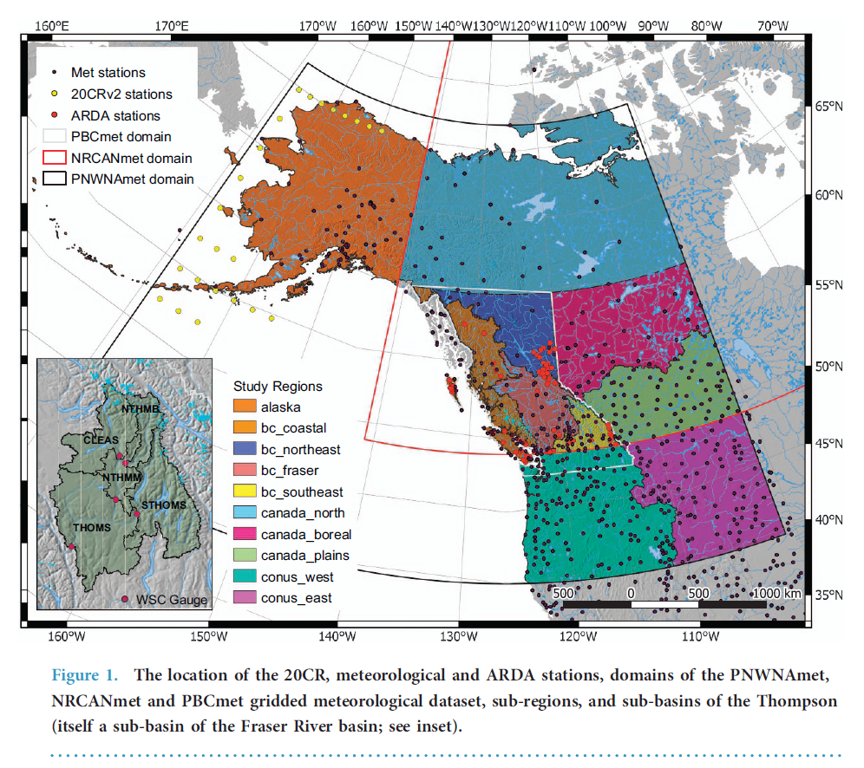
Daily Gridded Meteorological Datasets are created from interpolating observed station data to a grid.

Slide 13
Target Daily Gridded Meteorological Datasets Used in Statistical Downscaling at PCIC – Data Portal
https://pacificclimate.org/data/daily-gridded-meteorological-datasets

Slide 14
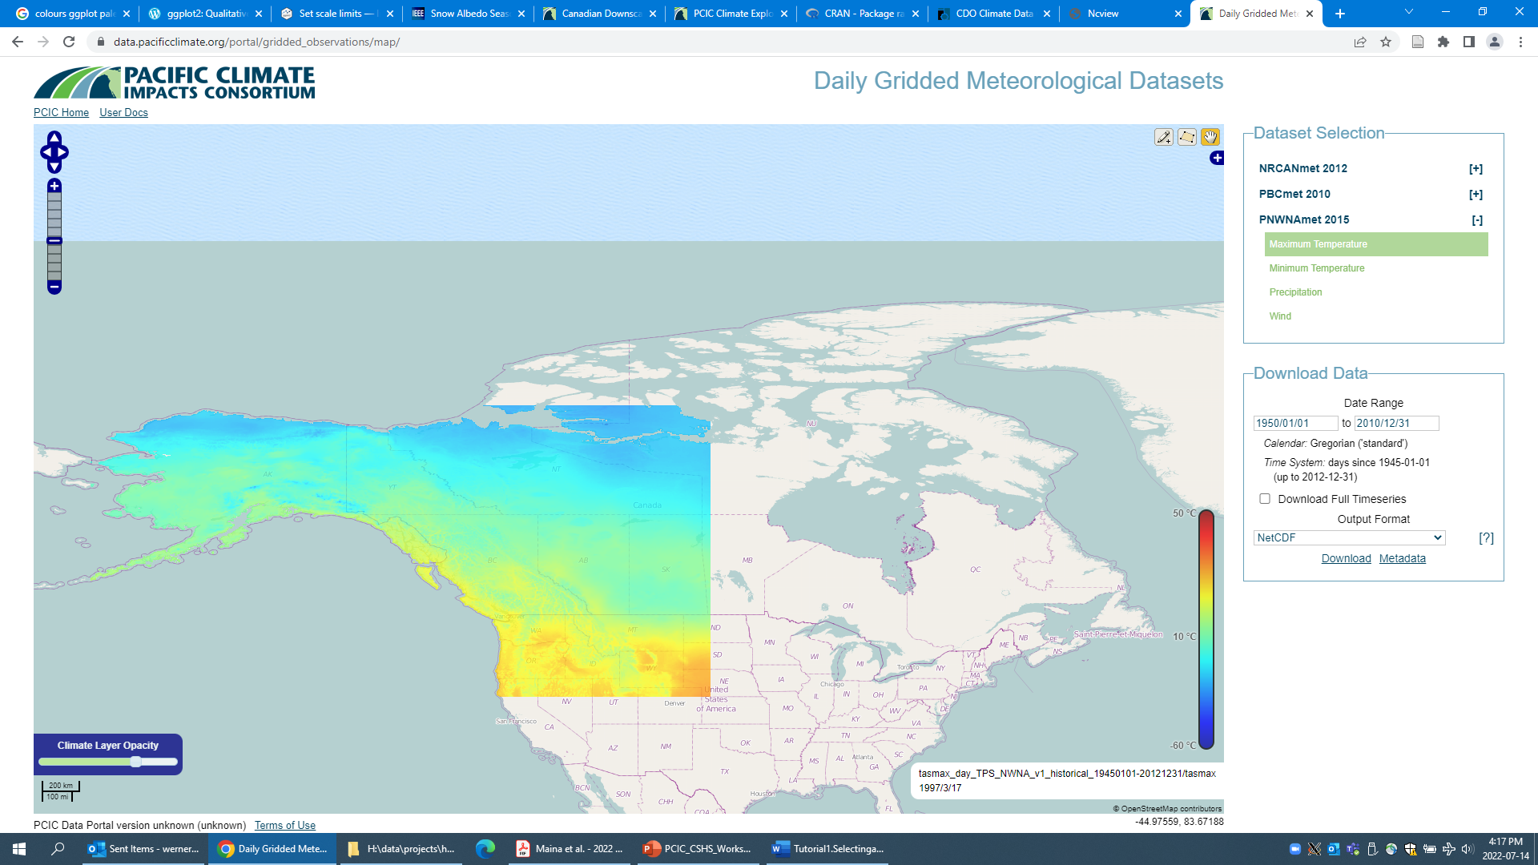
Target Daily Gridded Meteorological Datasets Used in Statistical Downscaling at PCIC - PNWNAmet

Slide 15
Target Daily Gridded Meteorological Datasets Used in Statistical Downscaling at PCIC - NRCANmet

Slide 16
BCCAQv2 has been found to be stronger than several other statistical downscaling approaches for temporal and spatial representation of daily temp. and prec.
Bias Correction/Constructed Analogues with Quantile Mapping Reordering (BCCAQv2)

Slide 17
The NRCANmet Daily Gridded Meteorological Dataset has a dry bias in the mountainous regions of BC and the Yukon versus PNWNAmet.

Slide 18
Other websites and tools where PCIC’s BCCAQv2 NRCANmet CMIP5 data is used:
• PCIC Climate Data Explorer
https://pacificclimate.org/analysis-tools/pcic-climate-explorer
• Prairie Climate Centre Climate Atlas
https://climateatlas.ca/
• Climatedata.ca
https://climatedata.ca/
• CCCS Climate Data Extraction Tool
https://climate-change.canada.ca/climate-data/#/downscaled-data
• IDF-CC Tool
https://www.idf-cc-uwo.ca/
• Power Analytics and Visualization for Climate Science (PAVICS)
https://www.crim.ca/en/computer-research-institute-of-montreal/achievements/pavics-power-analytics-and-visualization-for-climate-science
Hydrologic Projection Study Design – RCPs – GCMs – CMIP5 GCM Selection – BCCAQv2 Statistical Downscaling Technique

Slide 19
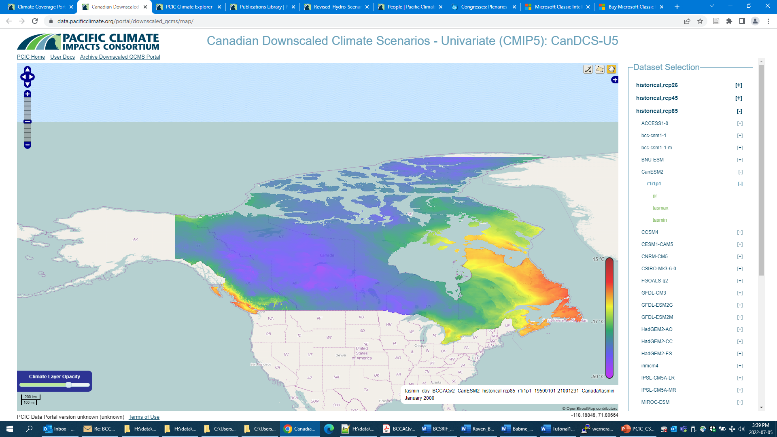
BCCAQv2 Statistically Downscaled Climate Scenarios NRCANmet (ANUSPLIN) are available across Canada.
Hydrologic Projection Study Design – RCPs – GCMs – CMIP5 GCM Selection – BCCAQv2 Statistical Downscaling Technique

Slide 20
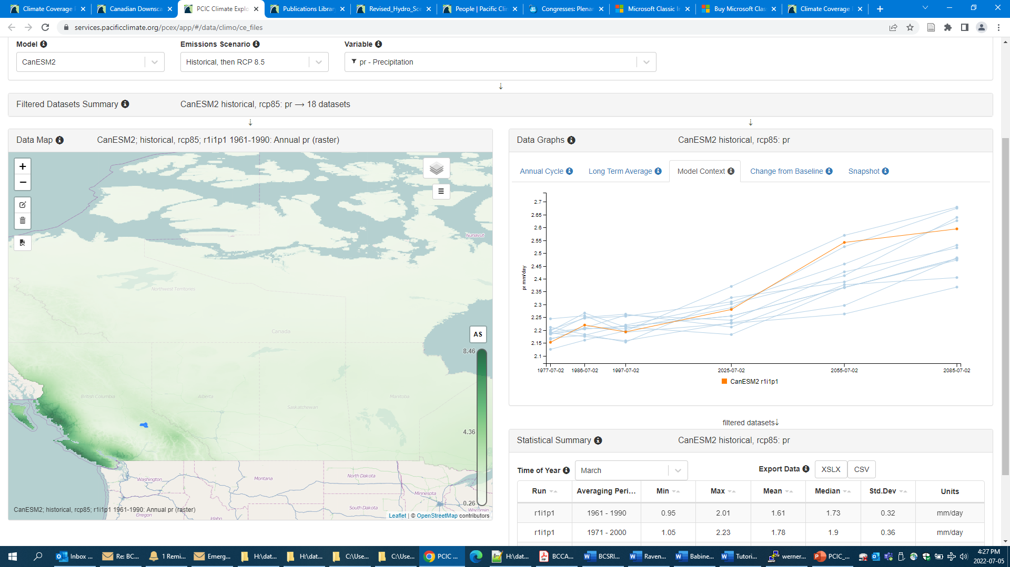
One can explore where the GCMs they’ve selected fit within the PCIC12 on PCIC’s Climate Explorer.
Create a simplified geojson watershed file
Import into the Climate Explorer
Hydrologic Projection Study Design – RCPs – GCMs – CMIP5 GCM Selection – BCCAQv2 Statistical Downscaling Technique

Slide 21
Summary
Because the future is uncertain we chose to look at a range of possible futures.
PCIC has summarized the top 12 CMIP5 GCMs the cover 90% of the range in T and P by Giorgi climate region on its data portal.
In our hydrologic projections study, we selected two RCPs and six GCMs to explore uncertainty contributed by emission trajectories, natural climate variability and GCM sensitivity to green house gas forcing.
We calibrate our hydrologic model to the same Daily Gridded Meteorological Dataset the statistical downscaling (BCCAQv2) is calibrated to.
For CMIP5 and CMIP6 BCCAQv2 statistically downscaled GCMs, NRCANmet is the Daily Gridded Meteorological Dataset GCMs were bias corrected against.

Slide 22
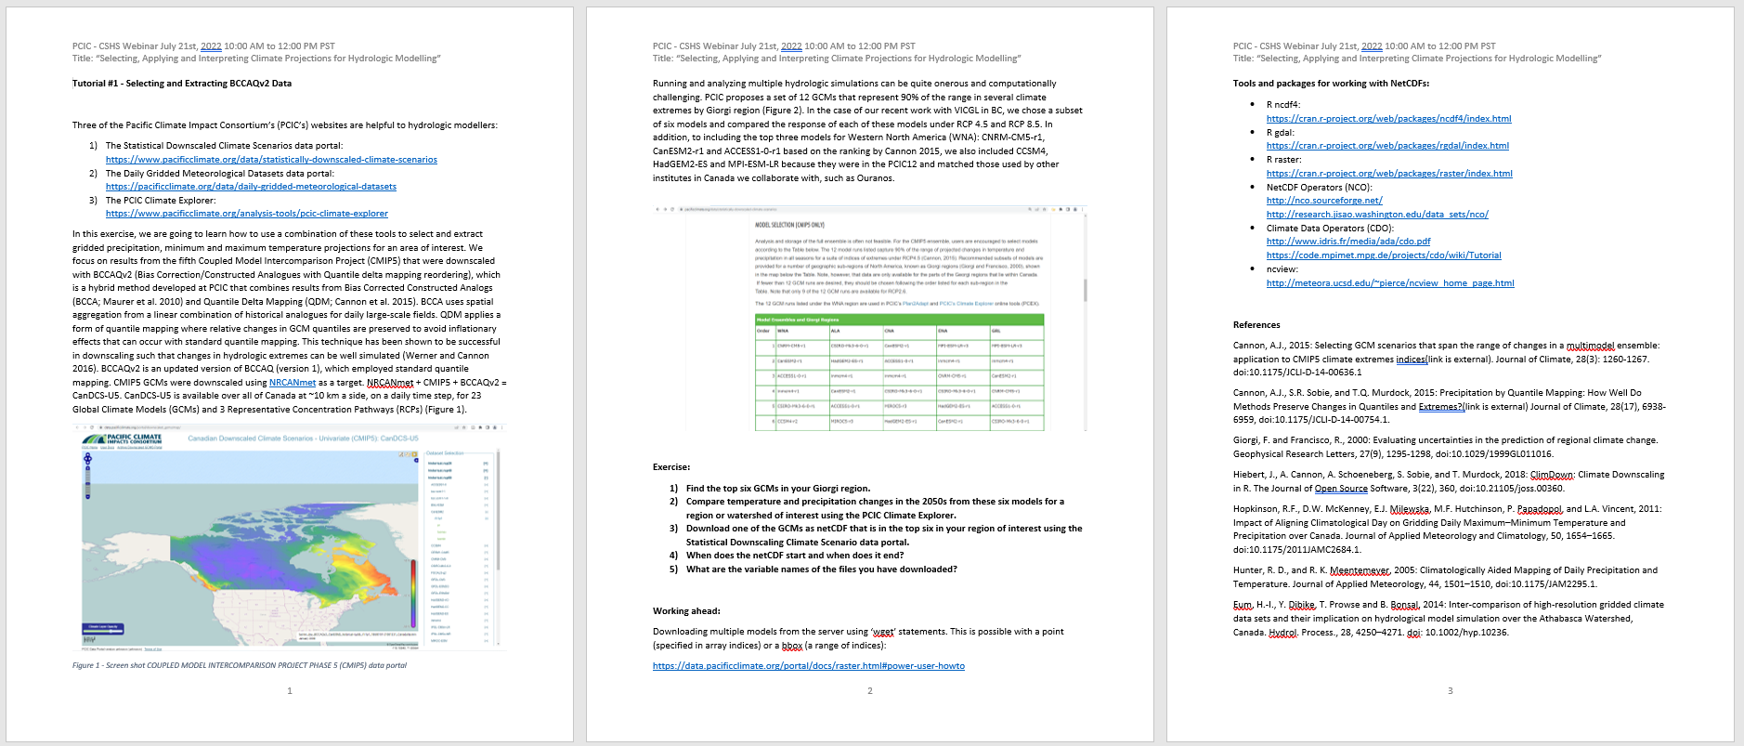
Tutorial #1 – Selecting and Extracting BCCAQv2 Data

Slide 23
Tutorial #1 - Selecting and Extracting BCCAQv2 Data
1) The Statistical Downscaled Climate Scenarios data portal:
https://www.pacificclimate.org/data/statistically-downscaled-climate-scenarios
2) The Daily Grided Meteorological Dataset data portal:
https://www.pacificclimate.org/data/daily-gridded-meteorological-datasets
3) The PCIC Climate Explorer:
https://www.pacificclimate.org/analysis-tools/pcic-climate-explorer
4) User Docs are your friend:
https://data.pacificclimate.org/portal/docs/raster.html#power-user-howto

Slide 24
Coupled Model Intercomparison Projects (CMIPs).
CMIPs are a collection of Global Climate Models that work along side the Intergovernmental Panel on Climate Change (IPCC) Assessment Reports with agreed on approaches.
PCIC recently used BCCAQv2 to downscale CMIP6. Now available.
A new GCM selection approach is being developed by Dhouha Ouali, Stephen Sobie, and Charles Curry for CMIP6. This is a PCIC initiative.
PCIC’s Hydrologic Projections are based on CMIP5.

